Slide 1

University of Central Florida COP 3330 Object Oriented Programming

Slide 2
Agenda
Administrative
Layout managers

Slide 3
Instructor
Instructor
Karin Whiting
Office location: HEC 412
Office hours
Monday, Wednesday, Friday @ 10:00 A.M. – 12:00 P.M.
Monday, Wednesday @ 2:00 – 4:00 P.M.
Email:
Please contact me via Webcourses

Slide 4
Teaching Assistants
Teaching Assistant
William Funk
Email: funk@ucf.edu
Teaching Assistant
Awrad Mohammad Ali
Email: award.emad@knights.ucf.edu
Teaching Assistant
Tuoerhongjiang Yusufu
Email: turgan@knights.ucf.edu
Teaching Assistant
Jun Xu
Email: junxu@knight.ucf.edu

Slide 5
Supplemental Instruction
SI Leader
John
OPAL hours (online):
Monday/Wednesday: 5:00 – 5:50 PM
https://ucf.adobeconnect.com/cop3330-object-oriented-programming-fall2015
https://goo.gl/Q7zix4
1. To enter a session, they should log in as a GUEST.
2. They will be prompted for a name. They should enter their first and last names.
3. Password (cASE-SenSiTive): OPAL

Slide 6
Supplemental Instruction
SI Leader
John
Day | Time | Room
Monday | 10:30 AM- 11:20 AM | CB1 307
Monday | 2:30 PM- 3:20 PM | CB1 318
Monday | 5:00 PM- 5:50 PM | Online
Wednesday | 5:00 PM- 5:50 PM | Online
Friday | 3:30 PM- 4:20 PM | CB1 107

Slide 7
Layout managers

Slide 8
Layout Managers
BorderLayout
BoxLayout
CardLayout
FlowLayout
GridBagLayout
GridLayout
GroupLayout
SpringLayout

Slide 9
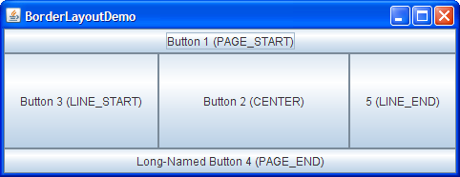
Layout Managers
BorderLayout
Default for the content pane of JFrame, JDialog, and JApplet
Arranges the components into five areas (before JDK release 1.4, the preferred names for the various areas were based on points of the compass)
NORTH
SOUTH
EAST
WEST
CENTER
Also known as (now the preferred standard because they enable programs to adjust to languages that have different orientations)
PAGE_START
PAGE_END
LINE_START
LINE_END
CENTER

Slide 10
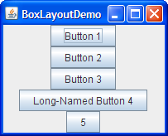
Layout Managers
BoxLayout
Puts components in a single row or column
It respects the components' requested maximum sizes
Lets you align components

Slide 11
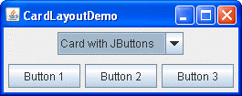
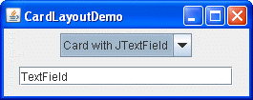
Layout Managers
CardLayout
Lets you implement an area that contains different components at different times
Often controlled by a combo box, with the state of the combo box determining which panel (group of components) to display
An alternative to using CardLayout is using a tabbed pane, which provides similar functionality but with a pre-defined GUI

Slide 12

Layout Managers
FlowLayout
Default for javax.swing.JPanel
Lays out components in a single row
Starting a new row if its container is not sufficiently wide
Places components sequentially left to right in the order they were added
Order can be specified if desired

Slide 13
GridBagLayout
GridBagLayout
One of the most flexible layout managers
One of the most complex layout managers
Places components in a grid of rows and columns (i.e. cells)
Allows for specified components to span multiple rows or columns
Not all rows necessarily have the same height
Similarly, not all columns necessarily have the same width
Uses the components' preferred sizes to determine how big the cells should be.

Slide 14
GridBagLayout
0 | 1 | 2 | 3
gridx (column)
0
1
2
3
gridy (row)

Slide 15
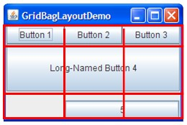
GridBagLayout
GridBagLayout
The grid has three rows and three columns
The button in the second row spans all the columns
The button in the third row spans the two right columns

Slide 16
GridBagConstraints
GridBagConstraints
The way the program specifies the size and position characteristics of its components
Specifying constraints for each component
The preferred approach to set constraints on a component is to use the Container.add variant, passing it a GridBagConstraints object

Slide 17
GridBagConstraints
JPanel pane = new JPanel(new GridBagLayout());
OR
pane.setLayout(new GridBagLayout());
OR
GridBagLayout gridBagLayout = new GridBagLayout();
pane.setLayout(gridBagLayout);
GridBagConstraints c = new GridBagConstraints();
pane.add(theComponent, c);

Slide 18
GridBagConstraints
// X is the column
// Y is the row
// W is the width in cells
// H is the height in cells
// aContainer is the container the component is added to
// aComponent is the component being added to the container
private void addComponent( int x, int y, int w, int h, Container aContainer, Component aComponent )
{
constraints.gridx = x;
constraints.gridy = y;
constraints.gridwidth = w;
constraints.gridheight = h;
gridBagLayout.setConstraints( aComponent, constraints );
aContainer.add( aComponent );
}

Slide 19
GridBagConstraints
// X is the column
// Y is the row
// W is the width in cells
// H is the height in cells
// aContainer is the container the component is added to
// aComponent is the component being added to the container
this.addComponent(0, 1, 1, 1, dataPane, fromDestLbl);

Slide 20
GridBagConstraints
Instance variables
gridx - Specifies the cell containing the leading edge of the component's display area, where the first cell in a row has gridx=0
gridy - Specifies the cell at the top of the component's display area, where the topmost cell has gridy=0.
gridwidth - Specifies the number of cells in a row for the component's display area.
gridheight - Specifies the number of cells in a column for the component's display area.
weightx - Specifies how to distribute extra horizontal space.
weighty - Specifies how to distribute extra vertical space.

Slide 21
GridBagConstraints
Instance variables
anchor - This field is used when the component is smaller than its display area.
fill - This field is used when the component's display area is larger than the component's requested size.
insets - This field specifies the external padding of the component, the minimum amount of space between the component and the edges of its display area.
ipadx - This field specifies the internal padding of the component, how much space to add to the minimum width of the component.
ipady - This field specifies the internal padding, that is, how much space to add to the minimum height of the component.

Slide 22
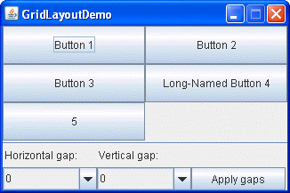
Layout Managers
GridLayout
Arranges the components into rows and columns
Components equal in size and displays them in the requested number of rows and columns

Slide 23
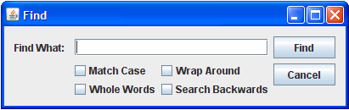
Layout Managers
GroupLayout
Developed for use by GUI builder tools
Can also be used manually
Works with the horizontal and vertical layouts separately; layout is defined for each dimension independently
However, each component needs to be defined twice in the layout

Slide 24
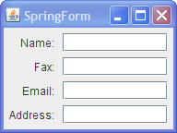

Layout Managers
SpringLayout
A flexible layout manager designed for use by GUI builders
Specify precise relationships between the edges of components under its control
Lays out the children of its associated container according to a set of constraints
Very low-level
Really should only use it with a GUI builder

Slide 25
Jframe ~ YahtzeeUi
ScoreCare UI ~ JPanel
rightPanel ~ JPanel
UpperSectionUi ~ JPanel
GameUi ~ JPanel
PlayerUi ~ JPanel
LowerSectionUi ~ JPanel
RollUi ~ JPanel
grandTotal ~ JLabel

